Slide 1
Dairy Creek Golf Course Project
Jake Altieri, Madison Chan, Celeste Johnson, Noah Pidding

Slide 2
Table of contents
01.
02.
03.
07.
04.
05.
06.
Introduction
Design
Measure
Conclusion
Analyze
Improve
Control

Slide 3
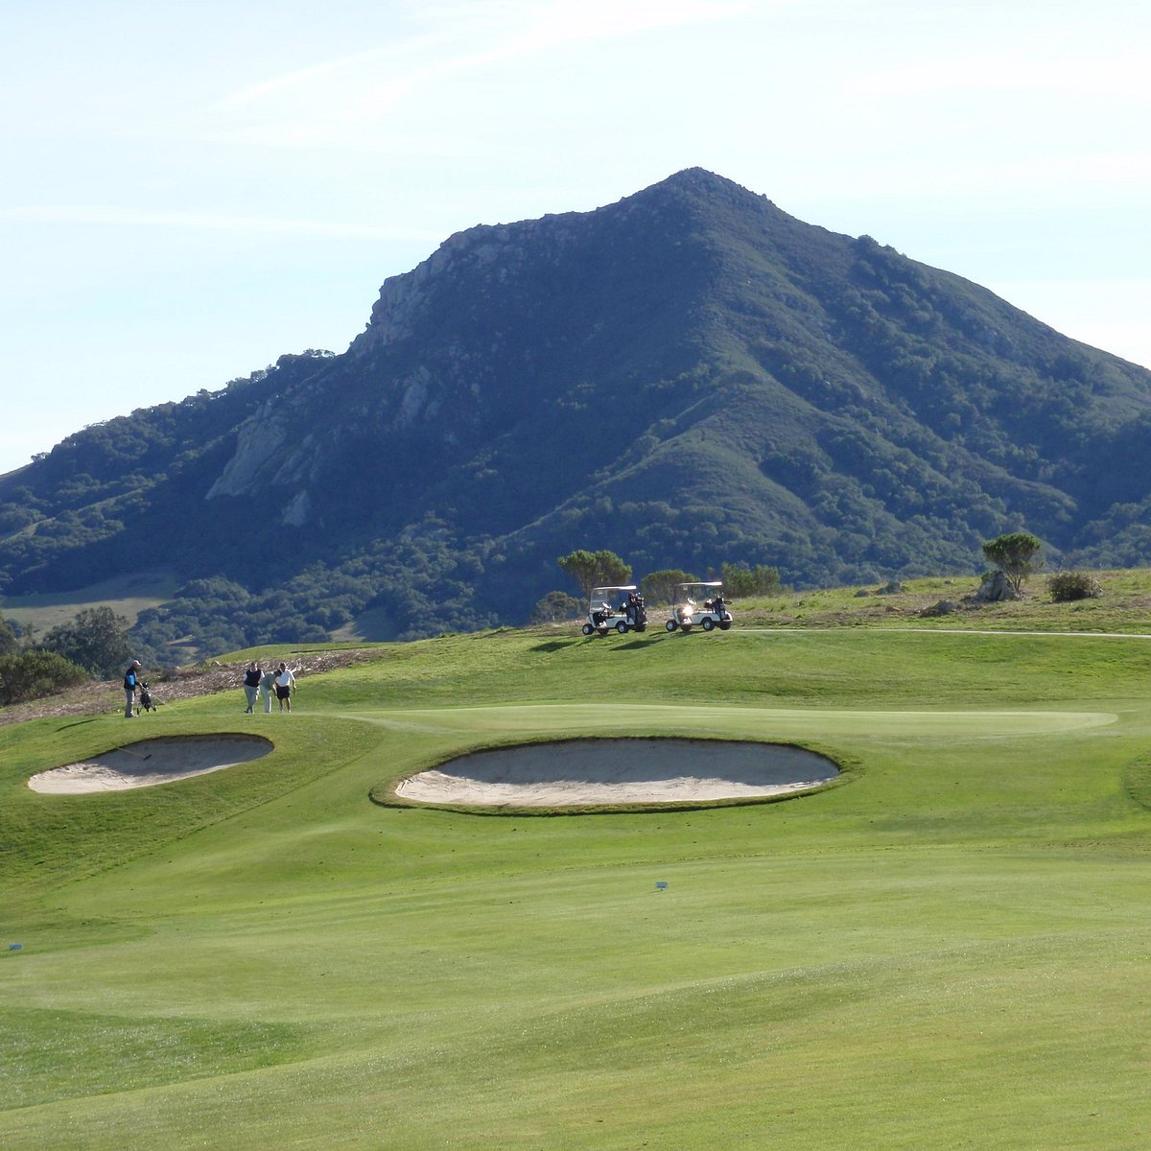
Background
The Dairy Creek Golf Course is a nine hole, 800 sq. ft. course located in San Luis Obispo, CA.
The golf course currently offers:
Driving Range
Short Game practice area
Putting Green
Cal Poly Practice Facility

Slide 4
02.
Define Phase

Slide 5

Problem Statement
Dairy Creek Golf Course experiences slow and inconsistent pace of play due to non-optimized tee times, uneven group distribution, bottlenecks on longer holes, and variability between walking and riding groups, resulting in delays, congestion, and reduced customer satisfaction.

Slide 6
Simulation Study Objectives
Our project aims to:
Improve pace of play (POP)
Optimize the number of players on the course
Increase the number of rounds played in a day
Determine optimal tee time intervals
Identify ideal number of carts to have available

Slide 7
Key Performance Measures
Average round completion time (total POP)
Average hole time and cycle time per hole
Idle / wait time between holes
Tee sheet utilization – % of slots filled
Group size distribution and walk vs ride ratio
Total groups and players completed per day

Slide 8
Scope of the Model
Simulates all 9 holes of Dairy Creek, modeling group flow, hole times, and course congestion
Groups vary by size, mode (walk/ride), and start time based on historical tee sheets.
Hole times use Visage data with fitted probability distributions
8-minute tee intervals and day-specific arrival schedules replicate real operations
Captures effects of peak hours, bottlenecks, and group size speed differences
Outputs: total round time, per-hole time, wait time, and groups completed per day

Slide 9
03.
Measure Phase

Slide 10
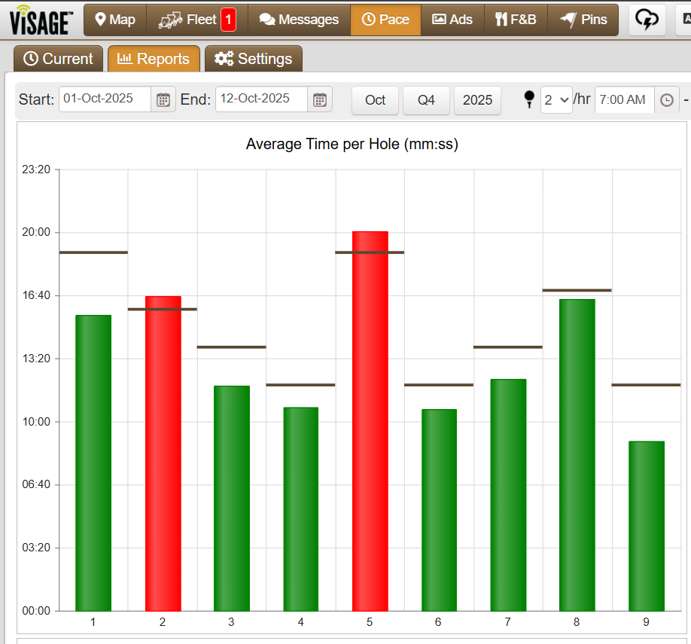
Data Collection
Data Sources:
Visage GPS tracking software
Tee sheets from Dairy Creek
Data Collected:
Average tee time per hole by day (Jan 2024 - Dec 2024)
Slot occupancy (probability a tee time is filled)
Group size

Slide 11
Assumptions
Course operates 7:00 AM–7:00 PM
Arrivals follow day-specific probabilities from historical tee sheets
Arrivals are on time
Groups of 1–4 players; mix varies by day with no mid-round changes
About 1/3 of groups walk, with higher walk share among smaller groups; walkers play slightly slower
Hole times use Visage data fitted to probability distributions; pace adjusted for group size and walk/ride
Peak-hour congestion and hole bottlenecks modeled via queues
Weather, skill level, and course layout assumed constant
All groups play holes 1–9 sequentially; no skipping or early exits

Slide 12
Visage Hole Time Analysis
Hole | Expected Time | Avg. Time | Distribution | Notes
Hole #1 | 19 min | 15.0 min | triangular (6.48, 20.91, 16.0)
Hole #2 | 16 min | 15.5 min | triangular (0, 23.08, 15)
Hole #3 | 14 min | 11.7 min | normal (1.87, 11.72)
Hole #4 | 12 min | 13.4 min | triangular (6.18, 13.85, 11)
Hole #5 | 19 min | 18.5 min | triangular (6.93, 29.7, 19)

Slide 13
Visage Hole Time Analysis
Hole | Expected Time | Avg. Time | Distribution | Notes
Hole #6 | 12 min | 10.0 min | triangular (6.4, 21.57, 10)
Hole #7 | 14 min | 11.8 min | normal (1.51, 11.76)
Hole #8 | 17 min | 16.1 min | triangular (7.92, 23.93, 16)
Hole #9 | 12 min | 9.7 min | triangular (0.87,18.38, 10)

Slide 14
Tee Sheet Analysis
Tee Time | 7:00 AM | 7:08 AM | 7:16 AM | … | 6:52 PM
Monday | 0.91 | 0.45 | 0.18 | … | 0.091
Tuesday | 0.83 | 0.75 | 0.67 | … | 0
Wednesday | 0.91 | 0.58 | 0.5 | … | 0
Thursday | 1 | 0.82 | 0.73 | … | 0
Friday | 1 | 0.75 | 0.5 | … | 0.083
Saturday | 1 | 1 | 0.83 | … | 0.083
Sunday | 0.91 | 1 | 1 | … | 0

Slide 15
Tee Sheet Analysis
Group Size | 1 | 2 | 3 | 4
Monday | 0.26 | 0.32 | 0.16 | 0.26
Tuesday | 0.30 | 0.29 | 0.19 | 0.22
Wednesday | 0.22 | 0.35 | 0.18 | 0.25
Thursday | 0.21 | 0.36 | 0.22 | 0.21
Friday | 0.15 | 0.22 | 0.23 | 0.40
Saturday | 0.08 | 0.19 | 0.19 | 0.54
Sunday | 0.08 | 0.20 | 0.19 | 0.53

Slide 16
04.
Analyze Phase

Slide 17
Current State Model

Slide 18
Current State Results
 | Avg Total Time | Rounds Completed
Current State

Slide 19
05.
Improve Phase

Slide 20
Potential Solutions
Dedicate staff member (marshal) to enforce quicker POP during peak hours
Force groups of 3 or 4 during peak hours
Adjust tee time intervals (15 minutes)
Force players to ride in carts
Add pace of play signage to longer / bottleneck holes
Adjust tee box positions or pin placements to reduce difficulty during busy times

Slide 21
Improvement Results
Improvement | Avg Total Time | Rounds Completed
Current State
Marshal Intervention |  | 128.2 / day
Late Fees |  | 137.6 / day
Adjust tee time interval |  | 115.8 / day

Slide 22
06.
Control Phase

Slide 23
Implementation Steps

Slide 24
Implementation Steps
Step 01
Step 02
Step 03
Step 04
Identifying objectives
Research and preparation
Developing strategies
Plans of action
Step 05
Step 06
Step 07
Step 08
Measuring progress
Continuous improvement
Analyzing outcomes
Focusing on the future

Slide 25
Thank you!

